Slide 1
WHY YOU SHOULD SWITCH TO
AZURE
CAPSTONE PROJECT
BY WILYIN GAO

Slide 2

HELLO!
My name is Wilyin Gao, it’s pronounced like William but with an “n”.
Cloud Engineer in training. Served as a Data Network Admin in the Marine Corps Reserves.

Slide 3
TABLE OF CONTENTS.
01
02
03
04
05
06
We will talk about key phrases and differences
We will talk about Public Subnetting second.
Then, we will talk about Private subnetting.
Bonus Differences.
We will also talk about COST!
And lastly, why you SHOULD switch to Azure Cloud!

Slide 4
KEY PHRASES &
DIFFERENCES
01
Between Azure and AWS Cloud of course.

Slide 5
DID YOU KNOW?
Azure Cloud
Virtual Network (VN)
Network Security Group (NSG)
Bastion
Public IP Addresses
AWS Cloud
Virtual Private Cloud (VPC)
Security Group
Bastion Gateway
Elastic IP Addresses

Slide 6
NOW WE WILL PUBLIC SUBNETTING
02

Slide 7
DID YOU KNOW?
Azure Bastion is a fully managed service, meaning Microsoft Azure handles the infrastructure, scaling, and maintenance.
Azure Bastion simplifies the setup process by providing a single secure web-based remote desktop or SSH client.
Azure Bastion eliminates the need to manage Elastic IPs (EIPs) or public IP addresses separately.
Azure Bastion is seamlessly integrated with Azure Active Directory (Azure AD), simplifying identity and access management.

Slide 8
Compare to…
AWS Cloud Bastion Hosts are instances that you have to manage and maintain.
AWS Cloud Bastion Hosts require manual configuration and may involve setting up additional security groups and routing.
AWS Cloud Bastion Hosts require an Elastic IP for connectivity, which adds complexity and cost.
👀
AWS Cloud Bastion Hosts Require additional configurations for identity management.

Slide 9
NOW WE WILL PRIVATE SUBNETTING
03

Slide 10
DID YOU KNOW?
Azure Database for PostgreSQL offers flexible pricing options, including serverless and provisioned compute, making it easier to match costs to your workload requirements.
Azure Database for PostgreSQL provides automatic failover and high availability as a standard feature without additional cost.
Azure Database for PostgreSQL integrates with Azure Active Directory for authentication and provides advanced security features like transparent data encryption, firewall rules, and threat detection.

Slide 11
Compare to…
AWS Aurora pricing is generally based on instance type and storage consumption.
AWS Aurora offers similar features but may involve additional configuration and cost considerations.
AWS Aurora AWS Aurora offers similar security features but may require additional setup.

Slide 12
Plenty O’ Differences
04

Slide 13
Bonus Differences
Azure
Hybrid Cloud allows organizations to integrate onsite servers.
Total support for Microsoft legacy Apps.
Greater awareness of enterprise needs.
Easy one-click migrations.
Support for mixed Linux/Windows environments.
Amazon SNS
Does not offer the best of Hybrid cloud offerings.
Less open private cloud. Unpopular storage option for sensitive industries.
Less suitable for companies with non-technically savvy customers.

Slide 14
Let’s Talk About Cost
05

Slide 15
LET’S REVIEW SOME FACTS.
 | VN/VP (2 NAT) | Postgre SQL (4 cores) | Key Vault (200,000) | Service Bus/SNS (20 Mill)
Azure | $78.70 | $266.37 | $0.60 | $1.00
AWS | $89.64 | $316.00 | $6.00 | $9.5

Slide 16
JUST DO IT
06

Slide 17
Recap
Azure Cloud is more user friendly as many of its features are automated. It’s features are highly customizable to ensure you it fits within your budget and necessities.
Azure Cloud features require less configuration than AWS Cloud to do the same job.
After configuring both Cloud options and comparing the prices, Azure Cloud is both cheaper and easier to set up.

Slide 18
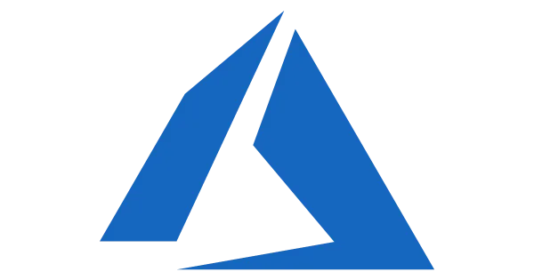
SWITCH TO
AZURE
TODAY!

Slide 19
THANK YOU!
GWILYIN@GMAIL.COM
+1(877)-KARS4KIDS
linkedin.com/in/wilyin-gao/
Do you have any questions?

